Slide 1
To help your dog enjoy a happy, healthy life, preventive care visits include the following:
 | Basic | Essential | Comprehensive
Comprehensive physical examination—Regular price $XX.XX This head-to-tail examination includes, but is not limited to, temperature, weight, and the evaluation of the following: Coat and skin Eyes, ears, mouth, teeth, and gums Heart, lungs, and abdomen Legs and paws
Complete blood count (CBC) and chemistry profile-Regular price $XX.XX A CBC can identify infection, inflammation, and anemia. A blood chemistry profile, including SDMA*, provides information about your dog’s kidneys, liver, and pancreas, as well as other functions of the body, such as blood sugar and hydration.
Complete urinalysis—Regular price $XX.XX This analysis assesses the overall health of your dog’s urinary tract, including kidneys and bladder. It identifies infection or inflammation in the urinary tract.
Infectious disease screening—Regular price $XX.XX This screening identifies whether your dog has been exposed to heartworm or important tick-borne diseases.
Fecal test—Regular price $XX.XX This test checks for intestinal parasites that may live in your dog’s gastrointestinal tract. Since they are usually hidden from view, the only way to detect and identify most intestinal parasites is by doing a fecal test.
Thyroid function test—Regular price $XX.XX A thyroid function test detects whether or not your dog’s thyroid gland is functioning properly. Thyroid disease is very common in older dogs.
Canine Cardiopet® proBNP heart disease screening test—Regular price $XX.XX This screening test provides an assessment of your dog’s heart health through a blood test.
Canine Spec® cPL™ pancreas disease screening test—Regular price $XX.XX Problems with the digestive organs may be due to an inflamed pancreas, diabetes, or some types of cancers.
Regular total cost: Discounted preventive care bundle: | $00.00 $00.00 | $00.00 $00.00 | $00.00 $00.00
[ Your logo here ]

Slide 2
To help your cat enjoy a happy, healthy life, preventive care visits include the following:
 | Basic | Essential | Comprehensive
Comprehensive physical examination—Regular price $XX.XX This head-to-tail examination includes, but is not limited to, temperature, weight, and the evaluation of the following: Coat and skin Eyes, ears, mouth, teeth, and gums Heart, lungs, and abdomen Legs and paws
Complete blood count (CBC) and chemistry profile-Regular price $XX.XX A CBC can identify infection, inflammation, and anemia. A blood chemistry profile, including SDMA*, provides information about your cat's kidneys, liver, and pancreas, as well as other functions of the body, such as blood sugar and hydration.
Complete urinalysis—Regular price $XX.XX This analysis assesses the overall health of your cat’s urinary tract, including kidneys and bladder. It identifies infection or inflammation in the urinary tract.
Infectious disease screening—Regular price $XX.XX This screening indicates whether your cat has been infected with feline leukemia virus (FeLV) and feline immunodeficiency virus (FIV)—the most common infectious diseases in cats. It also indicates exposure to heartworm.
Fecal test—Regular price $XX.XX This test checks for intestinal parasites that may live in your cat’s gastrointestinal tract. Since they are usually hidden from view, the only way to detect and identify most intestinal parasites is by doing a fecal test.
Thyroid function test—Regular price $XX.XX A thyroid function test detects whether or not your cat’s thyroid gland is functioning properly. Thyroid disease is very common in older cats.
Feline Cardiopet® proBNP heart disease screening test—Regular price $XX.XX This screening test provides an assessment of your pet’s heart health through a blood test.
Feline Spec® fPL™ pancreas screening test—Regular price $XX.XX Problems with the digestive organs may be due to an inflamed pancreas, diabetes, or some types of cancers.
Regular total cost: Discounted preventive care bundle: | $00.00 $00.00 | $00.00 $00.00 | $00.00 $00.00
[ Your logo here ]

Slide 3
To help your adult dog enjoy a happy, healthy life, this preventive care visit includes the following:
 | Cost
Comprehensive physical examination This head-to-tail examination includes, but is not limited to, temperature, weight, and the evaluation of the following: Coat and skin Eyes, ears, mouth, teeth, and gums Heart, lungs, and abdomen Legs and paws | $0.00
Complete blood count (CBC) and chemistry profile A CBC can identify infection, inflammation, and anemia. A blood chemistry profile, including SDMA*, provides information about your dog’s kidneys, liver, and pancreas, as well as other functions of the body, such as blood sugar and hydration. | $0.00
Complete urinalysis This analysis assesses the overall health of your dog’s urinary tract, including the kidneys and bladder. It identifies infection or inflammation in the urinary tract. | $0.00
Infectious disease screening This screening identifies whether your dog has been exposed to heartworm or other important tick-borne diseases. | $0.00
Fecal test This test checks for intestinal parasites that may live in your dog’s gastrointestinal tract. Since they are usually hidden from view, the only way to detect and identify most intestinal parasites is by doing a fecal test. | $0.00
Thyroid function test A thyroid function test detects whether or not your dog’s thyroid gland is functioning properly. Thyroid disease is very common in older dogs. | $0.00
Regular total cost: Discounted preventive care bundle: | $00.00 $00.00
[ Your logo here ]

Slide 4
To help your dog enjoy a happy, healthy life, this preventive care visit includes the following:
 | Cost
Comprehensive physical examination This head-to-tail examination includes, but is not limited to, temperature, weight, and the evaluation of the following: Coat and skin Eyes, ears, mouth, teeth, and gums Heart, lungs, and abdomen Legs and paws | $0.00
Complete blood count (CBC) and chemistry profile A CBC can identify infection, inflammation, and anemia. A blood chemistry profile, including SDMA*, provides information about your dog’s kidneys, liver, and pancreas, as well as other functions of the body, such as blood sugar and hydration. | $0.00
Complete urinalysis This analysis assesses the overall health of your dog’s urinary tract, including the kidneys and bladder. It identifies infection or inflammation in the urinary tract. | $0.00
Infectious disease screening This screening identifies whether your dog has been exposed to heartworm or other important tick-borne diseases. | $0.00
Fecal test This test checks for intestinal parasites that may live in your dog’s gastrointestinal tract. Since they are usually hidden from view, the only way to detect and identify most intestinal parasites is by doing a fecal test. | $0.00
Thyroid function test A thyroid function test detects whether or not your dog’s thyroid gland is functioning properly. Thyroid disease is very common in older dogs. | $0.00
Regular total cost: Discounted preventive care bundle: | $00.00 $00.00
[ Your logo here ]

Slide 5
To help your adult cat enjoy a happy, healthy life, this preventive care visit includes the following:
 | Cost
Comprehensive physical examination This head-to-tail examination includes, but is not limited to, temperature, weight, and the evaluation of the following: Coat and skin Eyes, ears, mouth, teeth, and gums Heart, lungs, and abdomen Legs and paws | $0.00
Complete blood count (CBC) and chemistry profile A CBC can identify infection, inflammation, and anemia. A blood chemistry profile, including SDMA*, provides information about your cat's kidneys, liver, and pancreas, as well as other functions of the body, such as blood sugar and hydration. | $0.00
Complete urinalysis This analysis assesses the overall health of your cat’s urinary tract, including the kidneys and bladder. It identifies infection or inflammation in the urinary tract. | $0.00
Infectious disease screening This screening indicates whether your cat has been infected with feline leukemia virus (FeLV) and feline immunodeficiency virus (FIV)—the most common infectious diseases in cats. A heartworm test is also included. | $0.00
Fecal test This test checks for intestinal parasites that may live in your cat’s gastrointestinal tract. Since they are usually hidden from view, the only way to detect and identify most intestinal parasites is by doing a fecal test. | $0.00
Regular total cost: Discounted preventive care bundle: | $00.00 $00.00
[ Your logo here ]

Slide 6
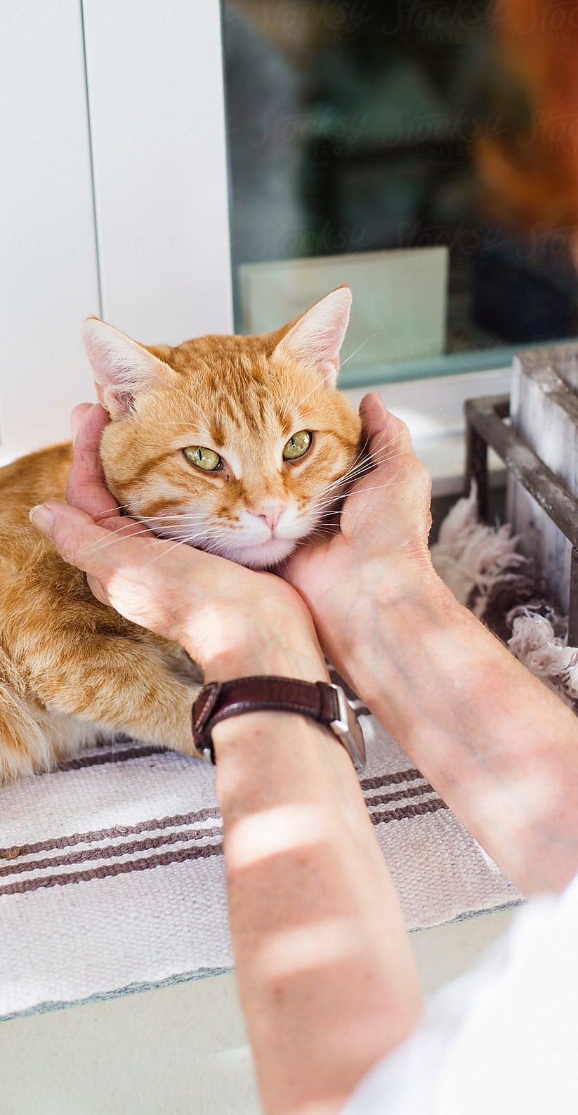
To help your cat enjoy a happy, healthy life, this preventive care visit includes the following:
 | Cost
Comprehensive physical examination This head-to-tail examination includes, but is not limited to, temperature, weight, and the evaluation of the following: Coat and skin Eyes, ears, mouth, teeth, and gums Heart, lungs, and abdomen Legs and paws | $0.00
Complete blood count (CBC) and chemistry profile A CBC can identify infection, inflammation, and anemia. A blood chemistry profile, including SDMA*, provides information about your cat's kidneys, liver, and pancreas, as well as other functions of the body, such as blood sugar and hydration. | $0.00
Complete urinalysis This analysis assesses the overall health of your cat’s urinary tract, including the kidneys and bladder. It identifies infection or inflammation in the urinary tract. | $0.00
Infectious disease screening This screening indicates whether your cat has been infected with feline leukemia virus (FeLV) and feline immunodeficiency virus (FIV)—the most common infectious diseases in cats. A heartworm test is also included. | $0.00
Fecal test This test checks for intestinal parasites that may live in your cat’s gastrointestinal tract. Since they are usually hidden from view, the only way to detect and identify most intestinal parasites is by doing a fecal test. | $0.00
Regular total cost: Discounted preventive care bundle: | $00.00 $00.00
[ Your logo here ]

Slide 7
To help ensure good health as your cat ages, this preventive care visit includes the following:
 | Cost
Comprehensive physical examination This head-to-tail examination includes, but is not limited to, temperature, weight, and the evaluation of the following: Coat and skin Eyes, ears, mouth, teeth, and gums Heart, lungs, and abdomen Legs and paws | $0.00
Complete blood count (CBC) and chemistry profile A CBC can identify infection, inflammation, and anemia. A blood chemistry profile, including SDMA*, provides information about your cat's kidneys, liver, and pancreas, as well as other functions of the body, such as blood sugar and hydration. | $0.00
Complete urinalysis This analysis assesses the overall health of your cat’s urinary tract, including the kidneys and bladder. It identifies infection or inflammation in the urinary tract. | $0.00
Infectious disease screening This screening indicates whether your cat has been infected with feline leukemia virus (FeLV) and feline immunodeficiency virus (FIV)—the most common infectious diseases in cats. A heartworm test is also included. | $0.00
Fecal test This test checks for intestinal parasites that may live in your cat’s gastrointestinal tract. Since they are usually hidden from view, the only way to detect and identify most intestinal parasites is by doing a fecal test. | $0.00
Thyroid function test A thyroid function test detects whether or not your cat’s thyroid gland is functioning properly. Thyroid disease is very common in older cats. | $0.00
Regular total cost: Discounted preventive care bundle: | $00.00 $00.00
[ Your logo here ]

Slide 8
To help ensure good health as your dog ages, this preventive care visit includes the following:
 | Cost
Comprehensive physical examination This head-to-tail examination includes, but is not limited to, temperature, weight, and the evaluation of the following: Coat and skin Eyes, ears, mouth, teeth, and gums Heart, lungs, and abdomen Legs and paws | $0.00
Complete blood count (CBC) and chemistry profile A CBC can identify infection, inflammation, and anemia. A blood chemistry profile, including SDMA*, provides information about your dog’s kidneys, liver, and pancreas, as well as other functions of the body, such as blood sugar and hydration. | $0.00
Complete urinalysis This analysis assesses the overall health of your dog’s urinary tract, including the kidneys and bladder. It identifies infection or inflammation in the urinary tract. | $0.00
Infectious disease screening This screening identifies whether your dog has been exposed to parasitic diseases, such as tick-borne diseases, heartworm, or other infectious diseases. | $0.00
Fecal test This test checks for intestinal parasites that may live in your dog’s gastrointestinal tract. Since they are usually hidden from view, the only way to detect and identify most intestinal parasites is by doing a fecal test. | $0.00
Thyroid function test A thyroid function test detects whether or not your dog’s thyroid gland is functioning properly. Thyroid disease is very common in older dogs. | $0.00
Regular total cost: Discounted preventive care bundle: | $00.00 $00.00
[ Your logo here ]

